Slide 1
Hellow
Myself
Kuntal Saha

Slide 2
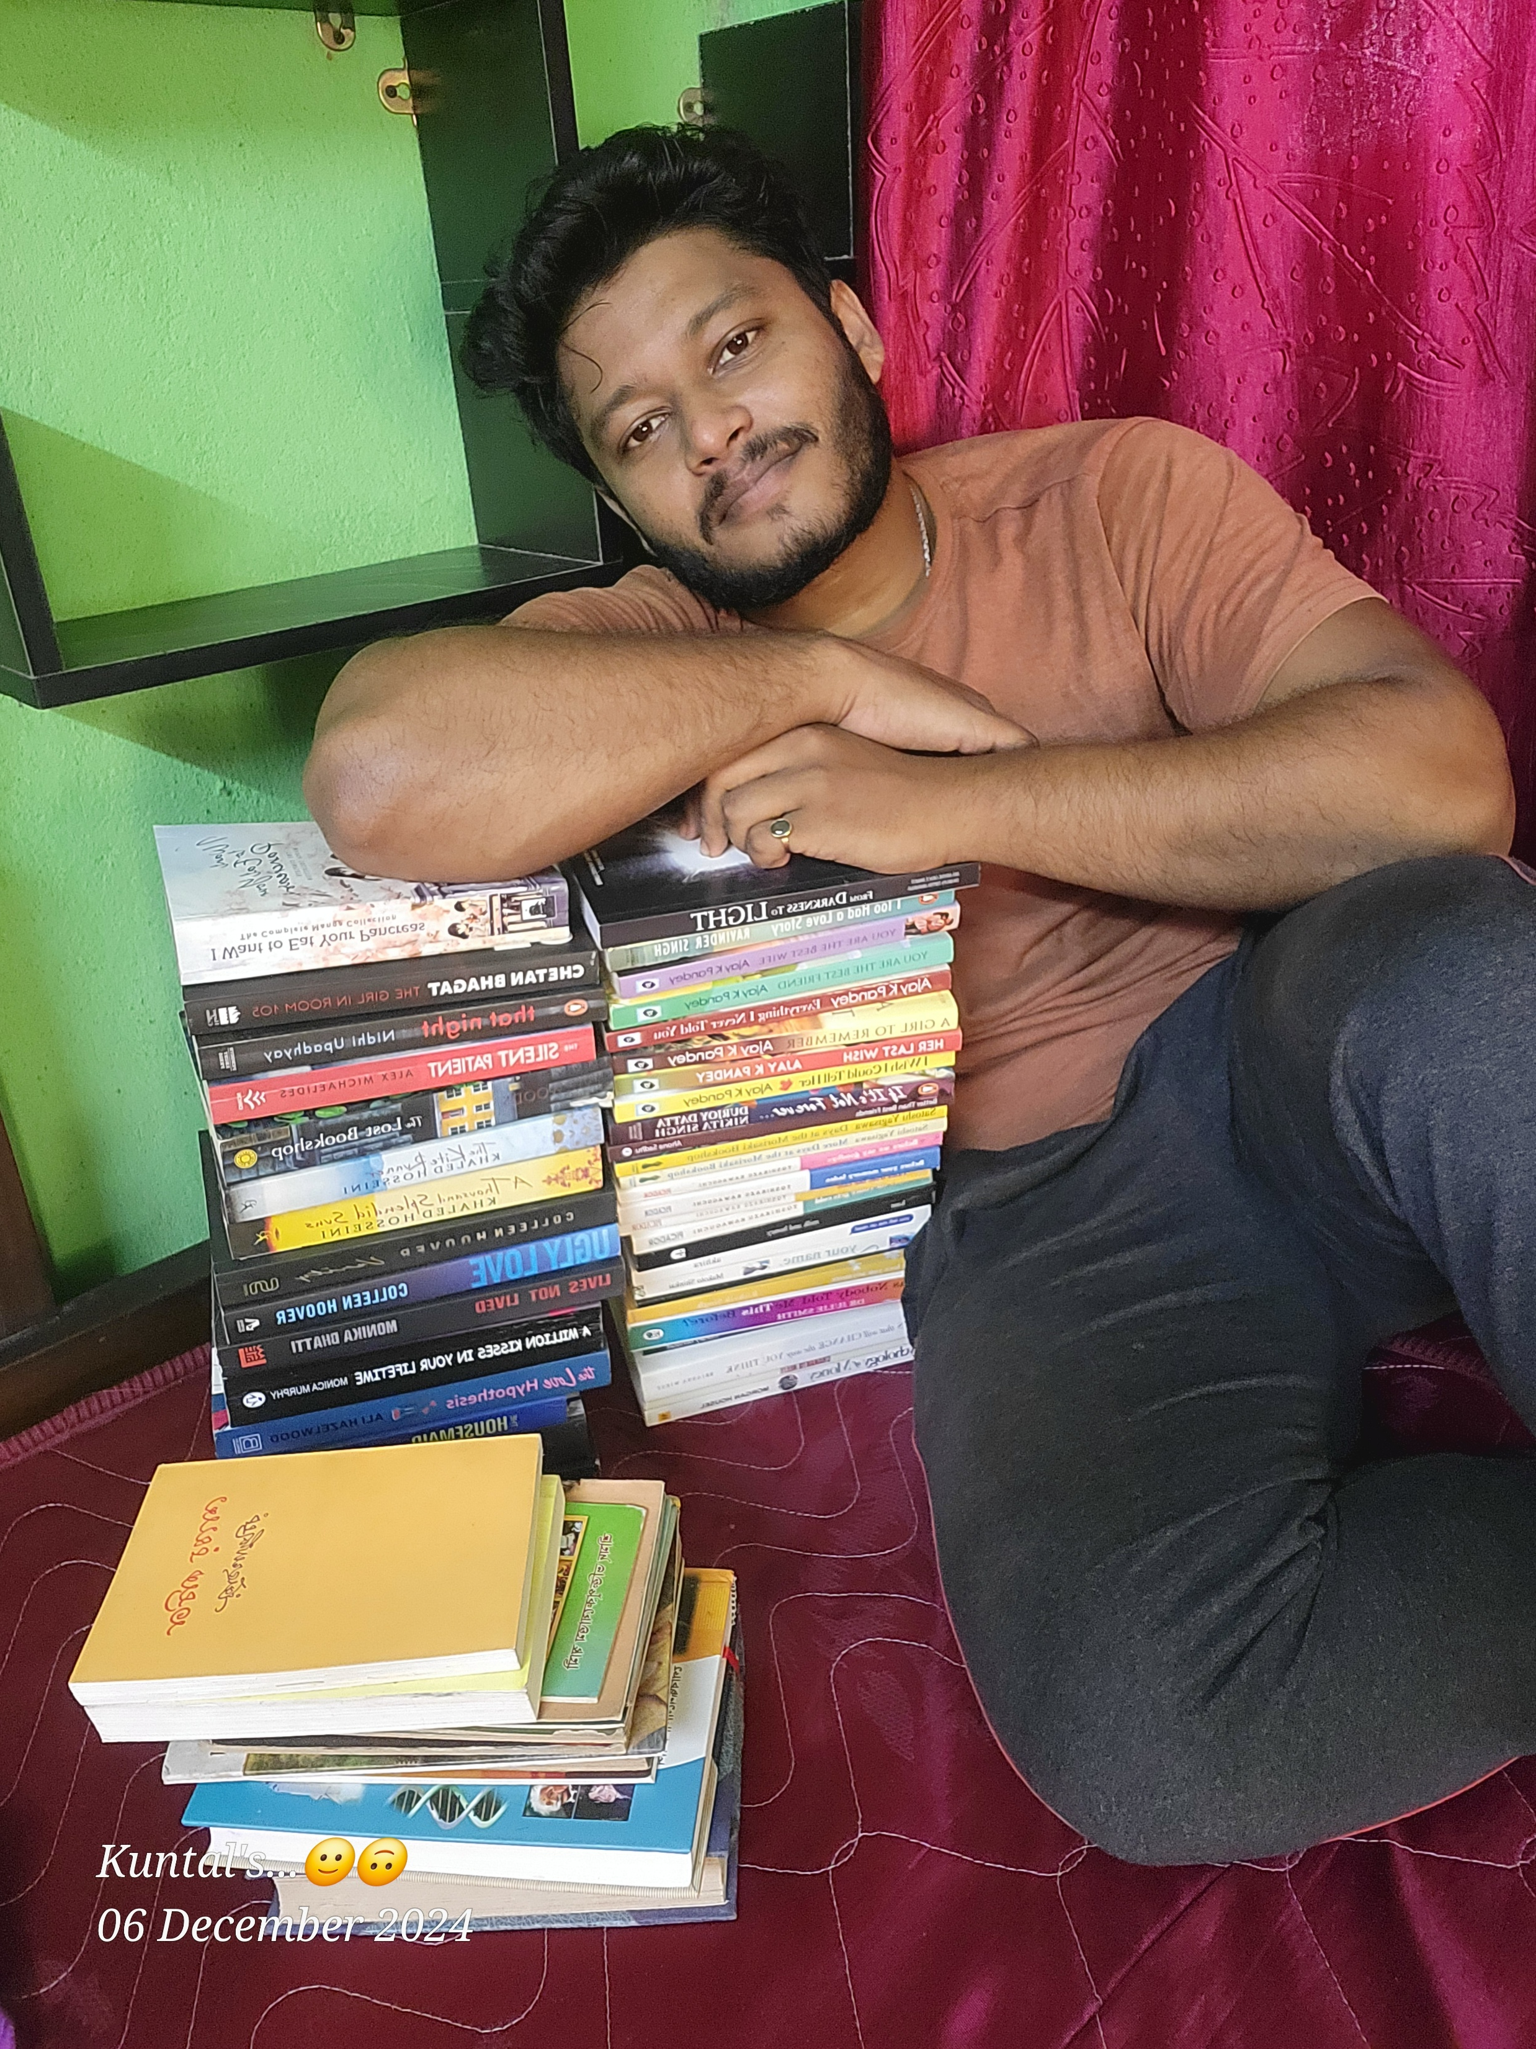
You might be thinking who this is actually..?!
This is Me

Slide 3
So, in next some slides I am about to tell you a little about myself…..
Why this Presentation is for..?
Where do I live..?
What is my Educational Background..?
What are my skills..?
What is my ultimate goal..?

Slide 4
Why this Presentation is for…?

Slide 5
This is to tell you guys a brief information about myself so that we can connect with each other better.
So,
I am an aspiring Data Analyst with a strong foundation in Statistics, Excel, Python, SQL and in some
of the visualisation and business intelligence tools like Power BI, Tableau. I have a good understanding
in deep drive into the data to fetch actionable insights and then take critical actions for the company’s growth.
I can turn raw data into interactive dashboards with the help of BI tools and Python so that we can understand
the data in a more friendly way.
Extras:- I like to read novels and ride motorcycles

Slide 6
Where do I live..?

Slide 7
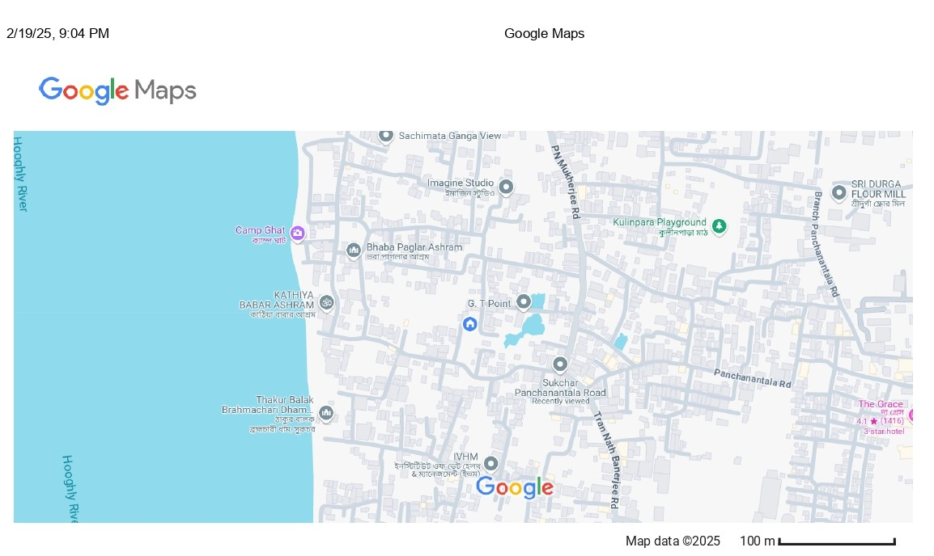
I am currently living in
Sukchar Panchanan Tala Road, Khardah, KOL- 700115
22.71275413735242, 88.36724023604988

Slide 8
What is my educational background..?

Slide 9
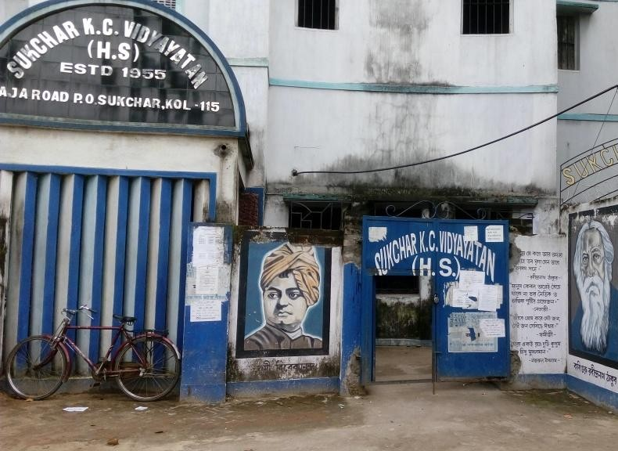
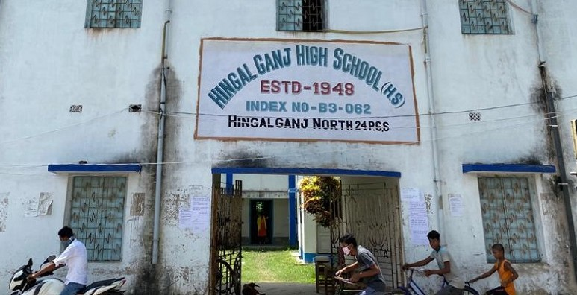
School
I was a part of two different schools for my Secondary and Higher Secondary Examinations
Secondary Eaxamination
(2016)
Higher Secondary Examination
(2018)

Slide 10
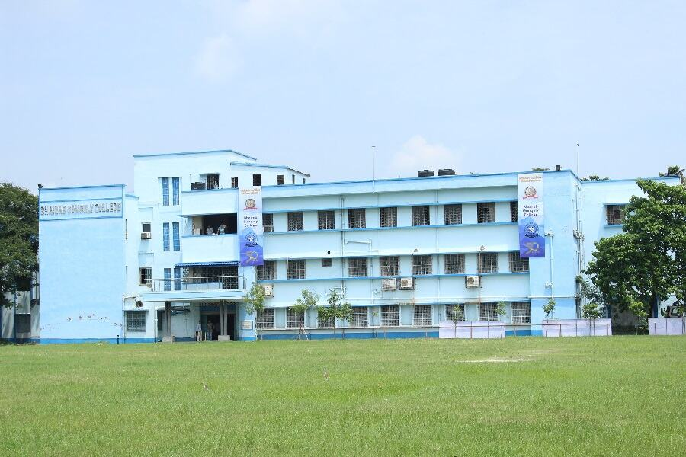

College
I have completed a Graduation in BA and a Certification in data analytics
Bhairab Ganguly College
Graduation (BA)
(2020-2024)
PW Skills
Mastering Full Stack Data Analytics
(2023 - 2024)

Slide 11
What are my skills..?

Slide 12
In the Data Analytics field, I have developed some skills to fit in this data driven era.
That are
Proficient in Writing Complex SQL Quarrys
Microsoft Power BI with DAX Quarries
Visualization Tool Tableau
Statistics for Data Analytics
Analytical Excel Skills
Python Programing Language for Data Analytics
Python Libraries Like Pandas, Numpy, Matplotlib, Seaborn, Sklearn
Decision Taking Ability After Analysis of a Data

Slide 13
What is my ultimate goal..?

Slide 14
The ultimate goal is to create an active income source.
After that travel to every corner of INDIA with my own Motorbike
and to have the audacity to go to every Book Fair and buy Hardcover Books.
Lastly, I want to build my own customized library at my Home.

Slide 15


This was a small intro about Myself. I hope we can find some similar interests.
You can connect with me
74778 - 07772
Kuntals332@Gmail.com

Slide 16
The
End
Thank you for being with me…!!

